Slide 1
Cooking App

Slide 2
THE BRIEF
STAKEHOLDERS
“Design a cooking app that shows recipes based on what ingredients user has at home.”
Siblings living together

Slide 3
THE GOALS
STAKEHOLDER:
Show recipes based on what ingredients user has at home
Maintaining the cooking schedule according to user preference.
Have more than one profiles containing information about likes and dislike food items/ ingredients.
Easily find recipes based on user favourites and like food items.

Slide 4



Target audience
Siblings living together and away from their parent's home.
Our personas are:
Alisen
Berry

Slide 5
Alisen
Persona 01
She is independent individual living with her younger brother in Toronto downtown. She is a software developer. She has a big friend circle. So her friends come home for dinner or lunch once a week. “She finds a hard time to coordinate cooking schedule with her brother as they both are busy, which leads to ordering food from outside”. She loves cooking and trying new recipes.

Slide 6
Berry
Persona 02
He is a student in university, living with his elder sister in Toronto downtown. Spends most time traveling from home to university. He always busy in his assignments and study, that results in “finding a hard time to coordinate the cooking time with his sister”. He only knows his mother’s recipe but likes to try different cuisines on his free days by finding videos on youtube.

Slide 7
ASSUMPTIONS AND RATIONALE BEHIND RESEARCH
The target audience likes trying different cuisines but does not have a good source to find a recipe.
Having a cooking schedule will solve the problem of coordinating cooking time with other members in the same house.
A user wants to see more recipes based on their food preferences.

Slide 8
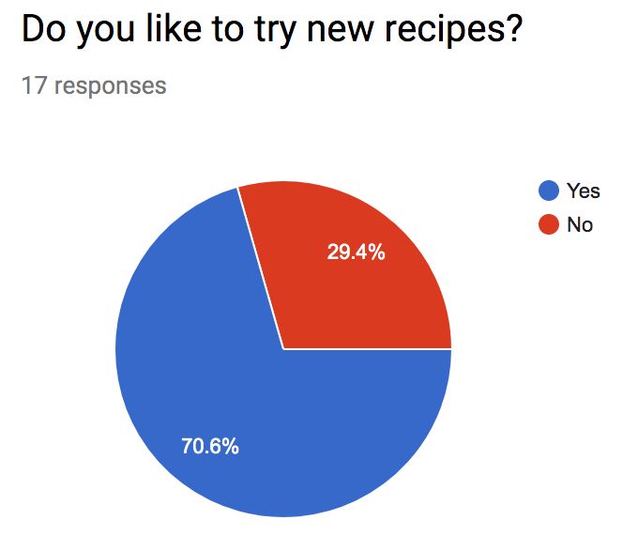
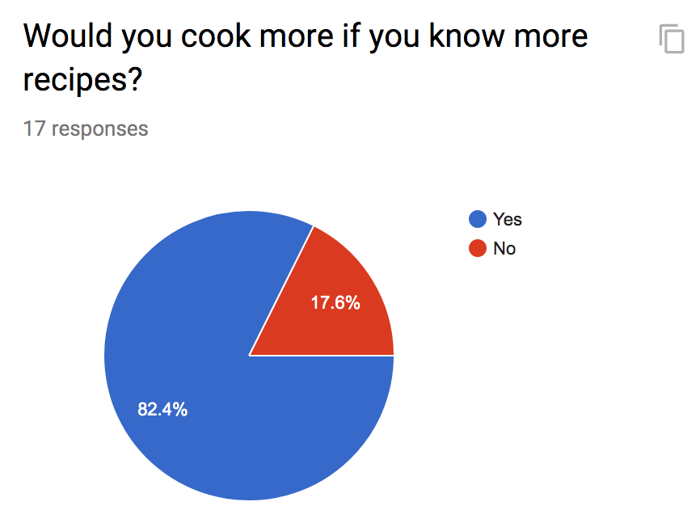
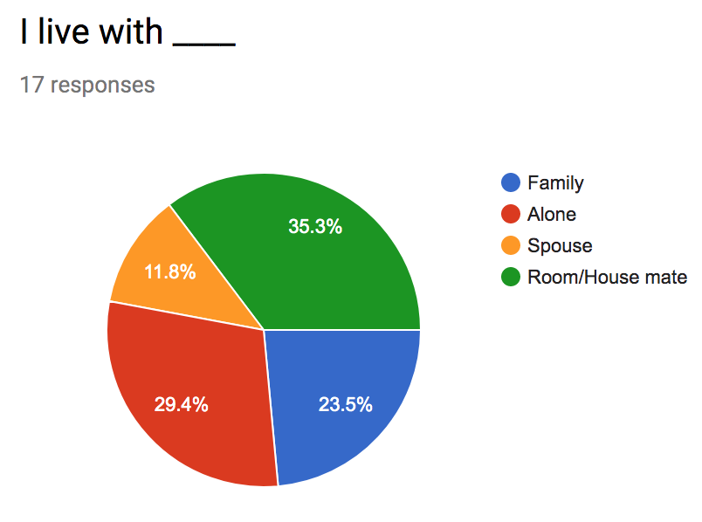
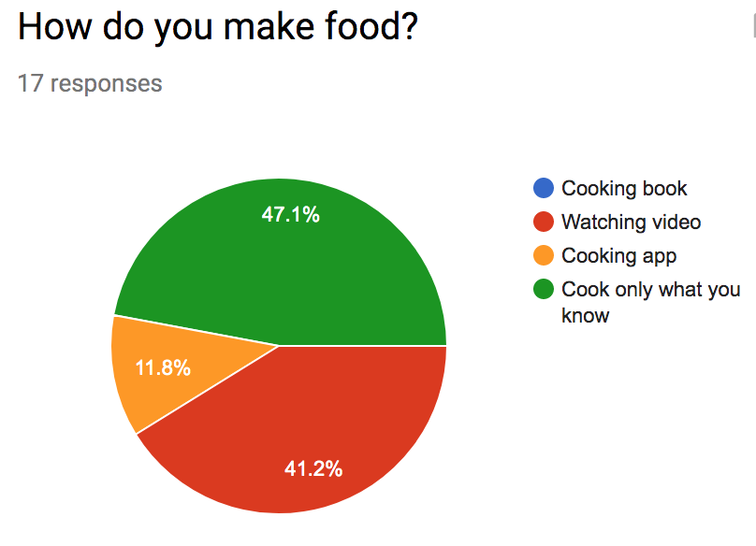
RESEARCH ARTIFACTS
How do you make food?
Would you cook more if you know more recipes?
Do you like to try new recipes?
Who do u live with?
What age group are you in?
How often do you cook at home?

Slide 9
Redefined brief
Create a cooking app which shows suggestions according to user preferences, maintain a cooking schedule and find recipes based on ingredients user have at home.

Slide 10
COMPETITIVE
ANALYSIS.

Slide 11
Supercook
This website let user select the ingredients and shows the suggested recipes according to ingredients. Then we can filter by Diet, Key ingredient, Meal type and cuisine. On the left side of page you can select the ingredients sorted by the type of food. For example dairy, vegetables, fruits etc. It will show the list of dish with pictures that you can make from the selected ingredients. The recipes are from different cooking websites. If you click on the dish we will see different interface for different recipes. When we select the dish. It will show the percentage of people tried this recipe and likes. It shows all photos uploaded by users. It will show all the requirements and details for preparing dish step by step.
Gap - As it links to the different cooking site so it do not have same interface/ layout for all recipes which will confuse the user. ( different cooking site like foodnetwork.com, myrecipes.com, food.com etc )

Slide 12
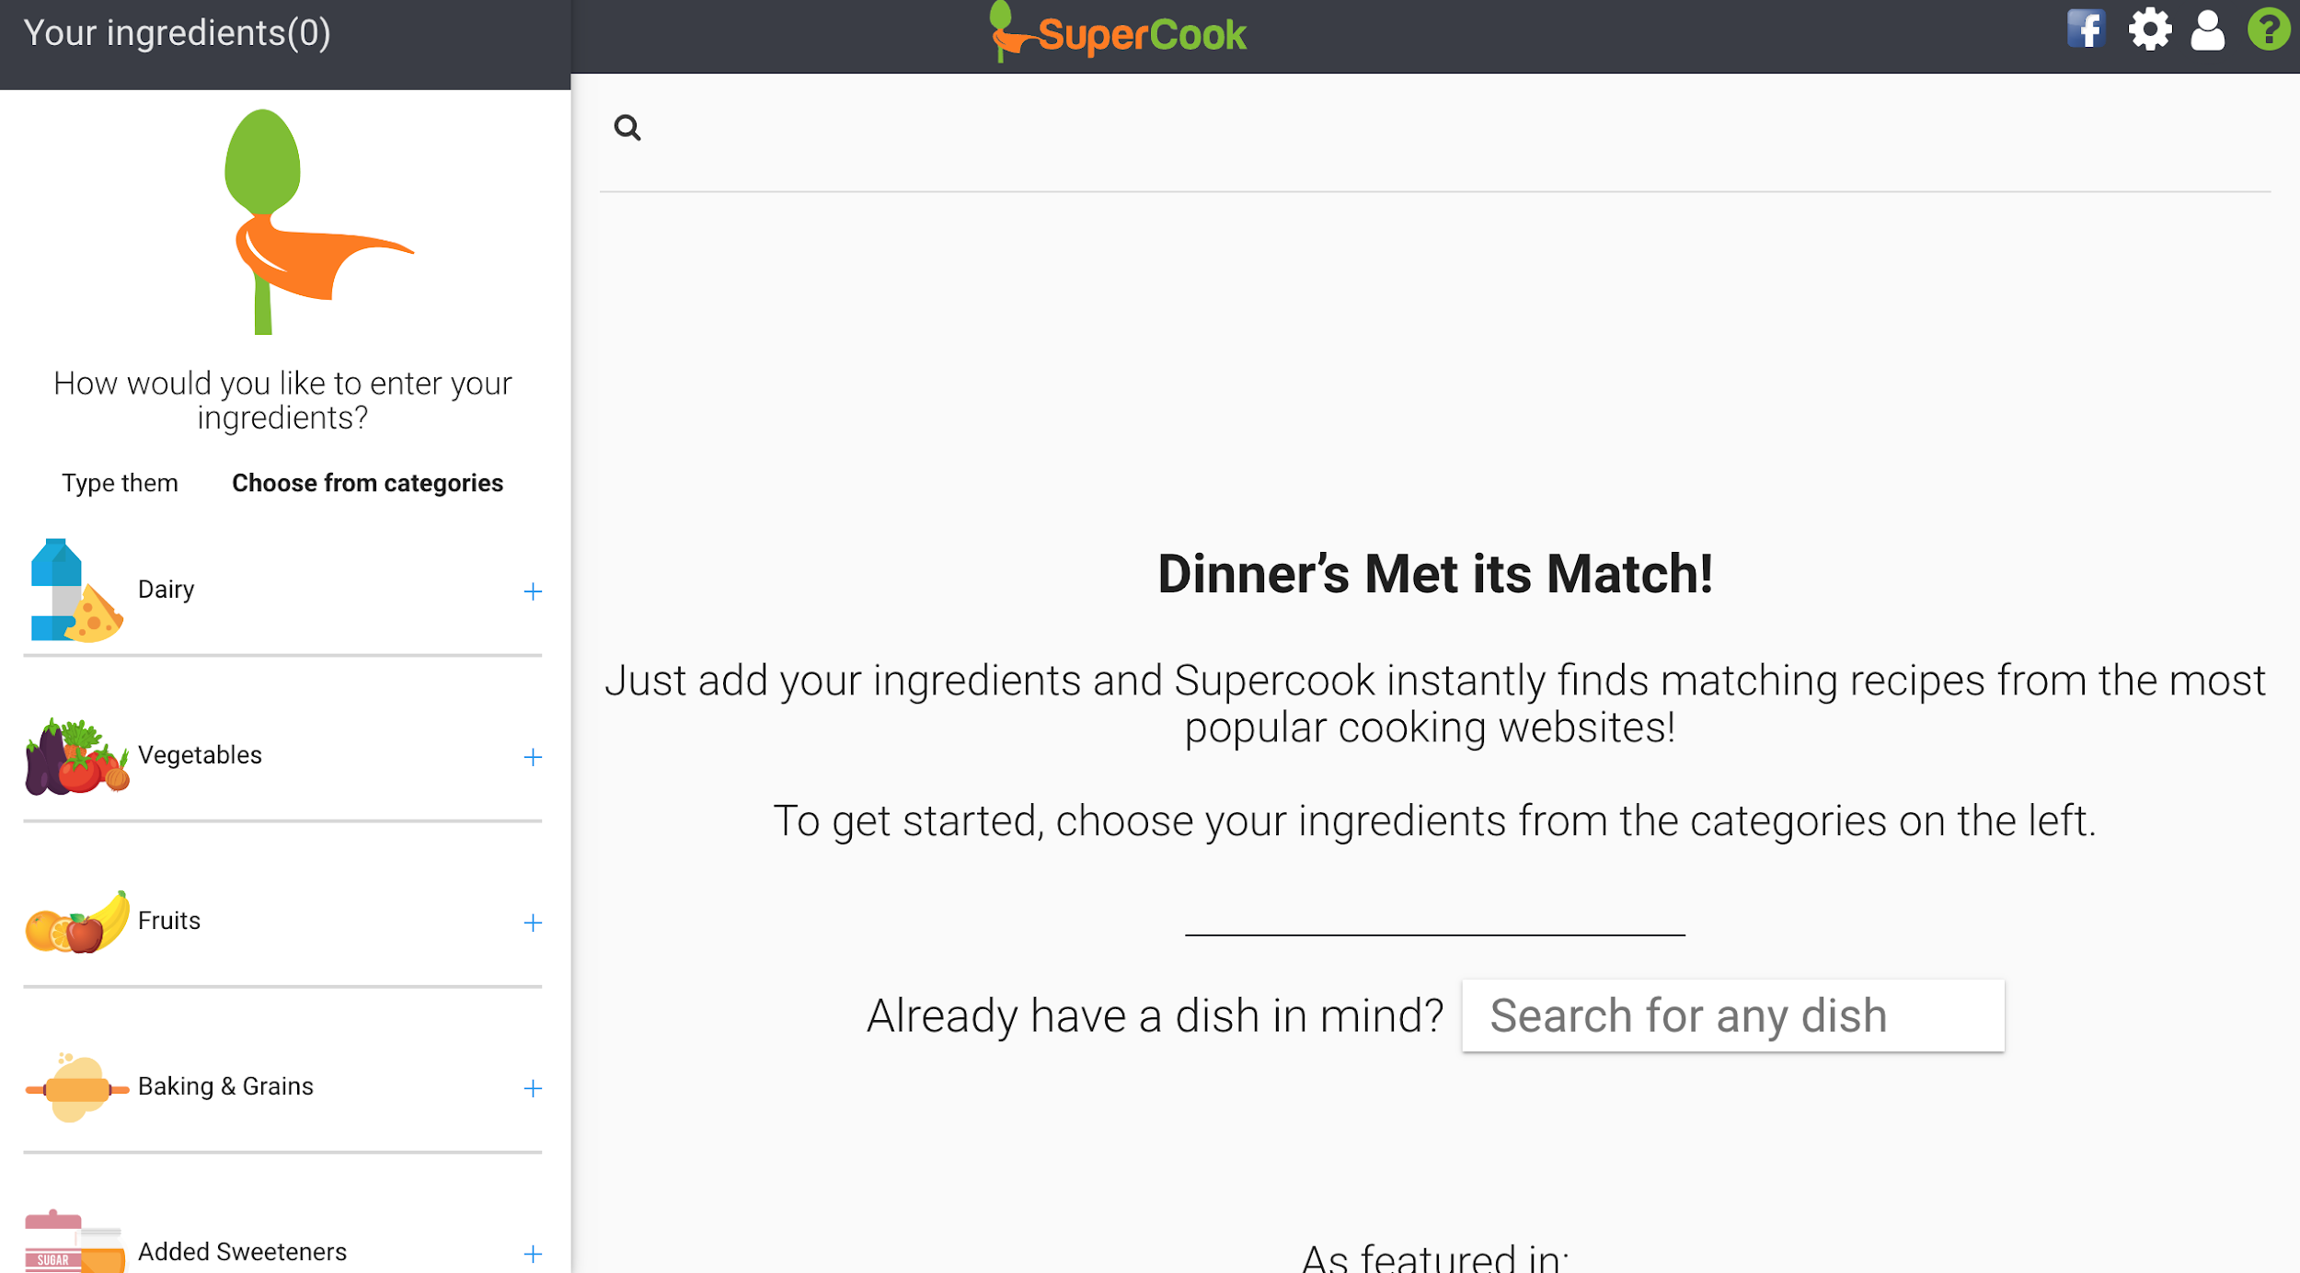
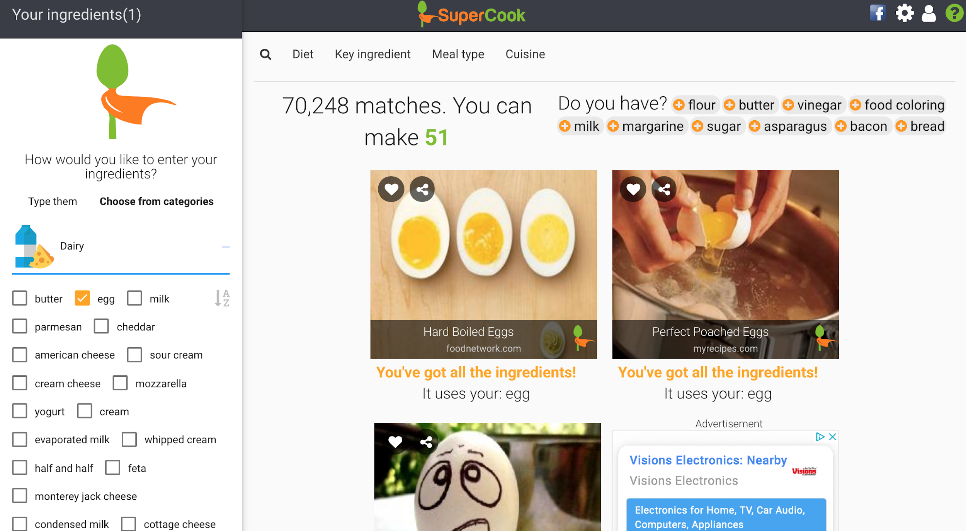
APPLICATION NAME: Supercook
HOME
SELECT CATEGORY

Slide 13
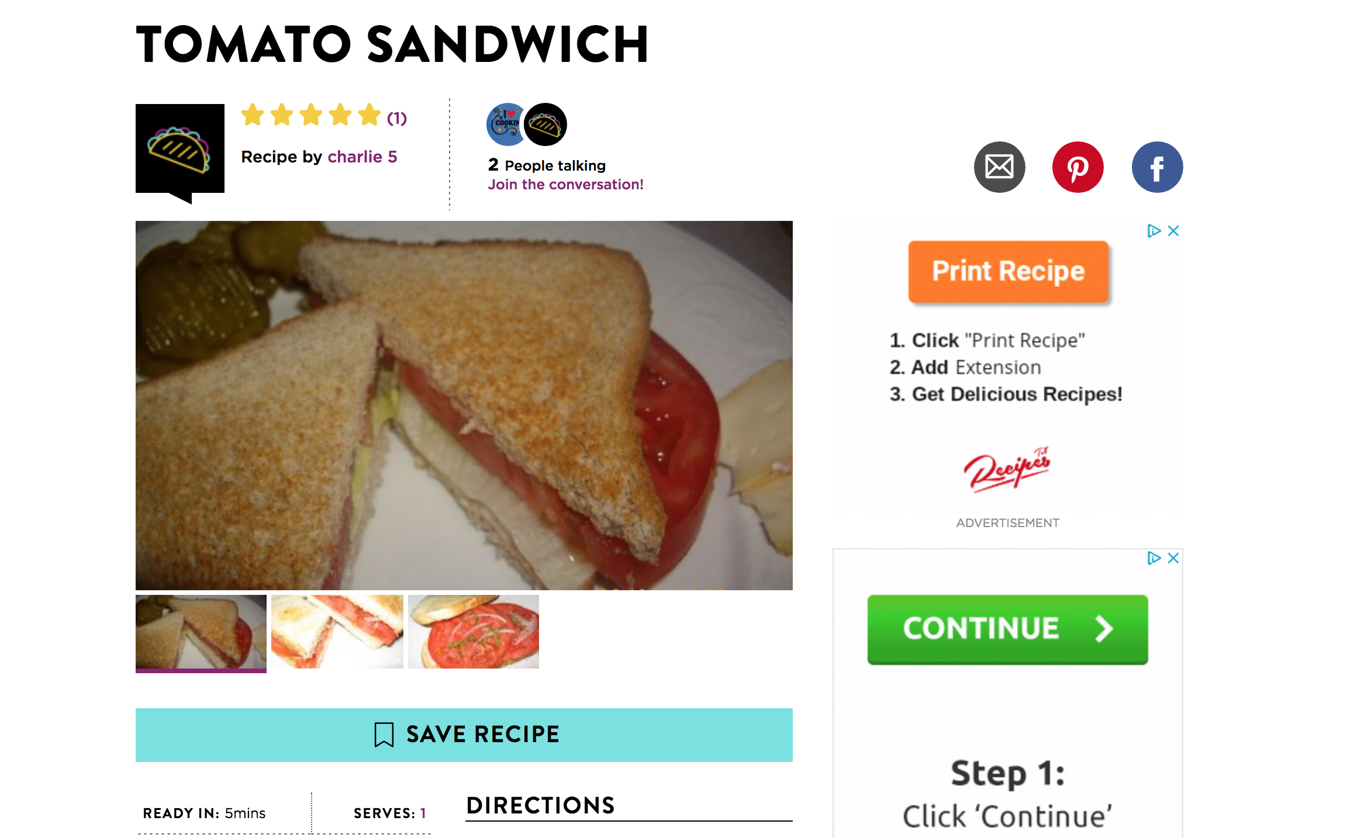
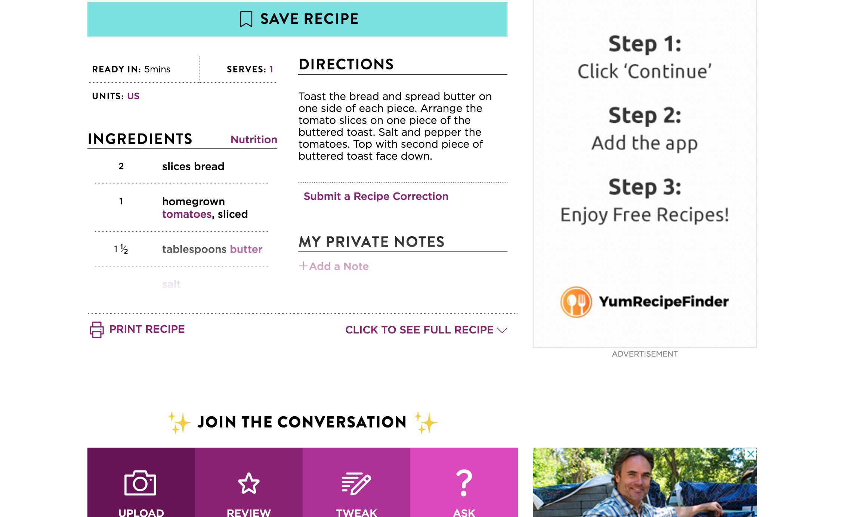
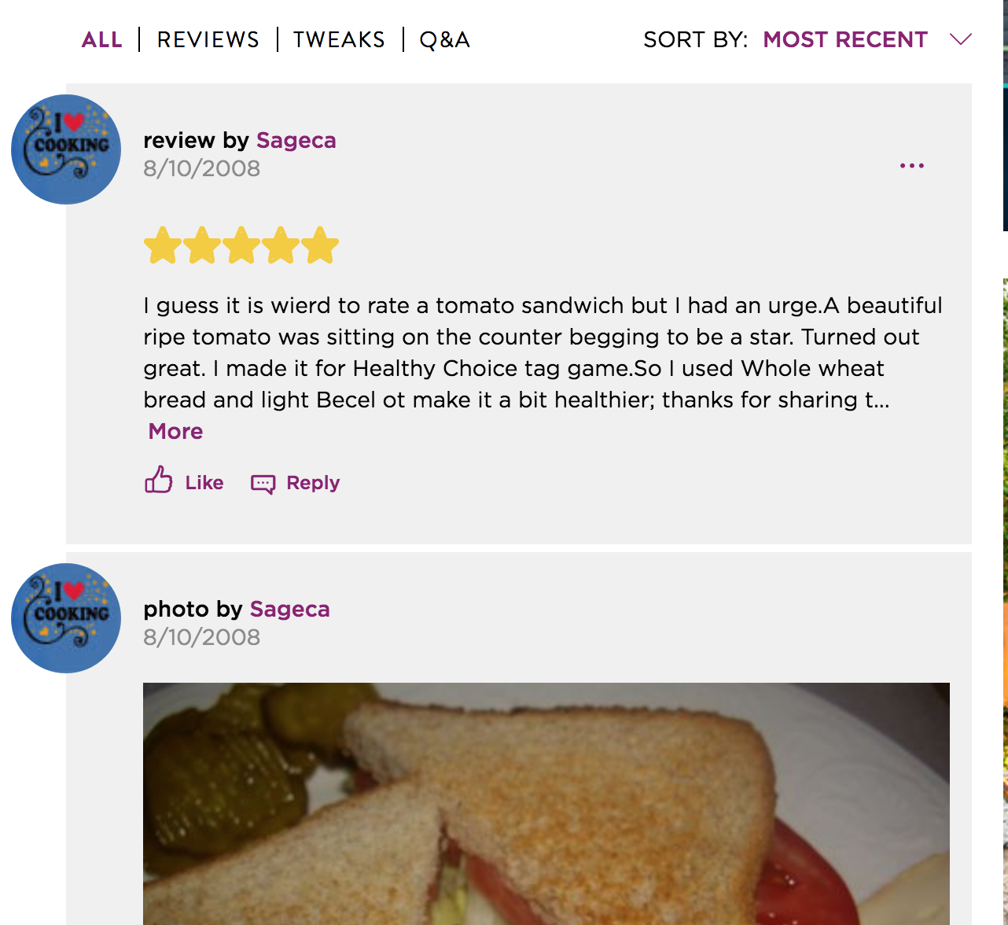
Photos of recipe
Instructions
geniuskitchen.com
Reviews

Slide 14
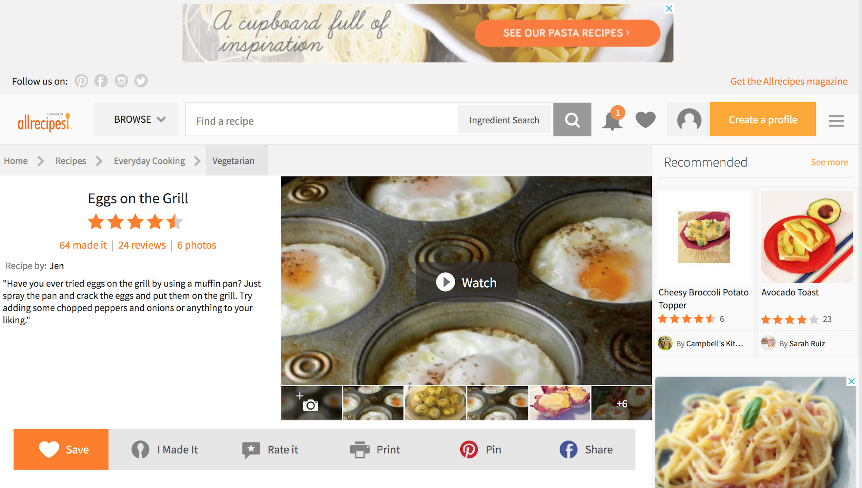
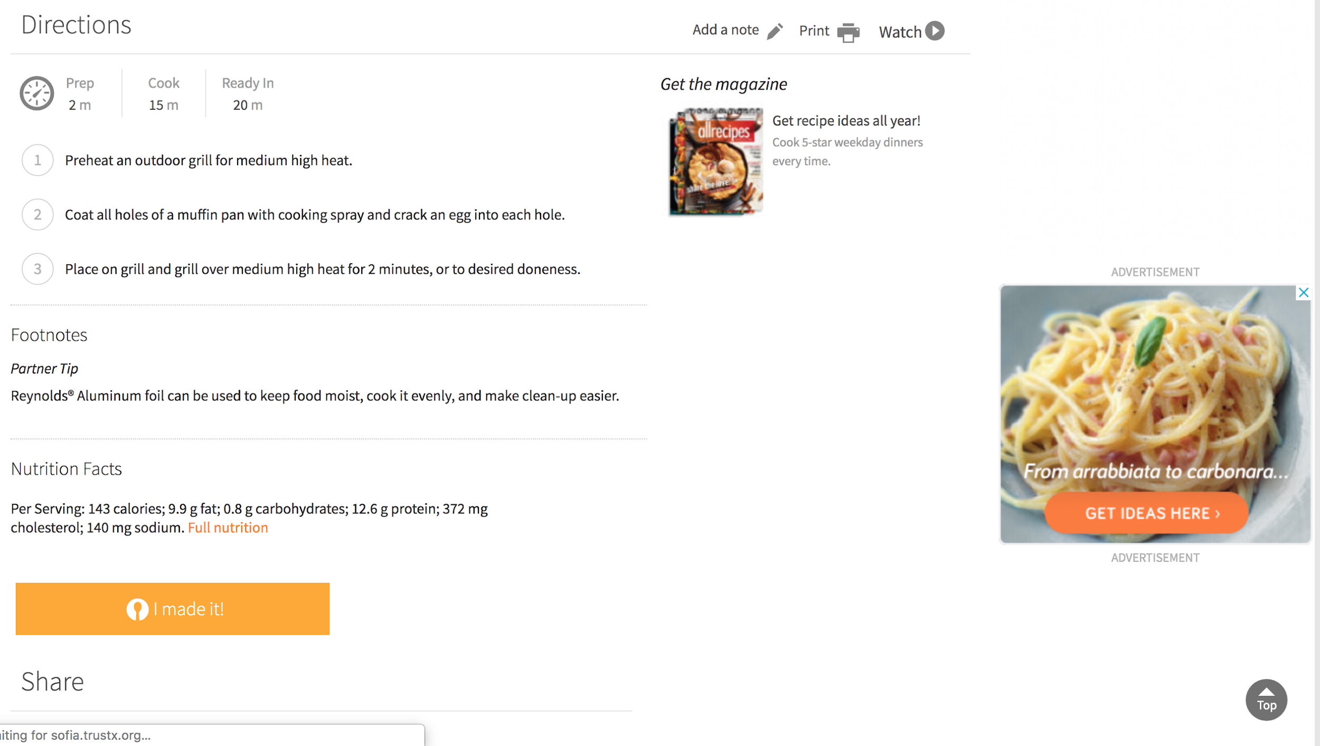
Similar features but have different layout because Supercook give link to actual website showing the selected recipe.
allrecipes.com

Slide 15
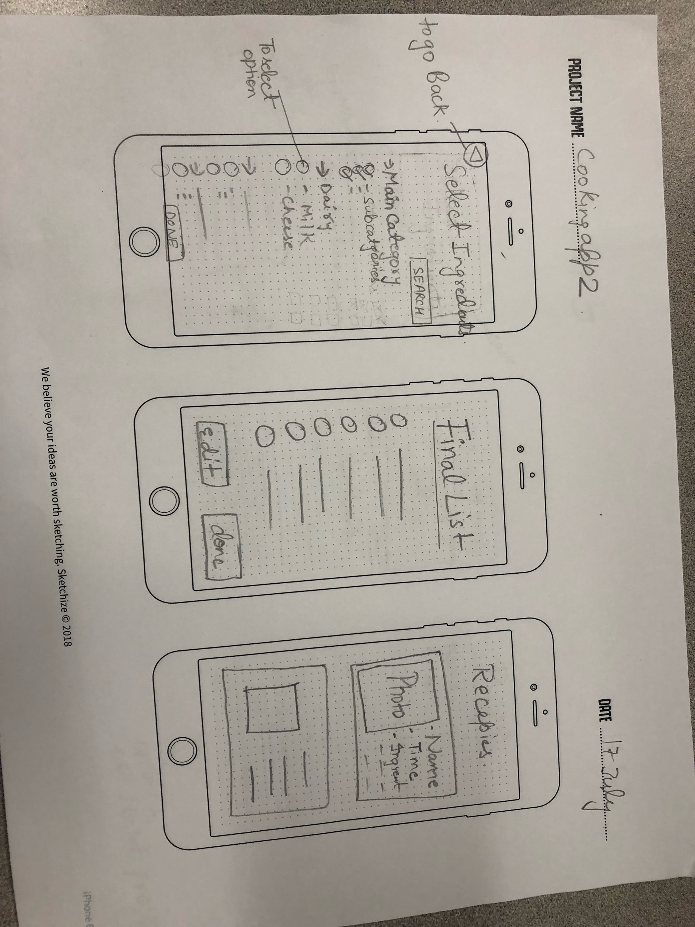
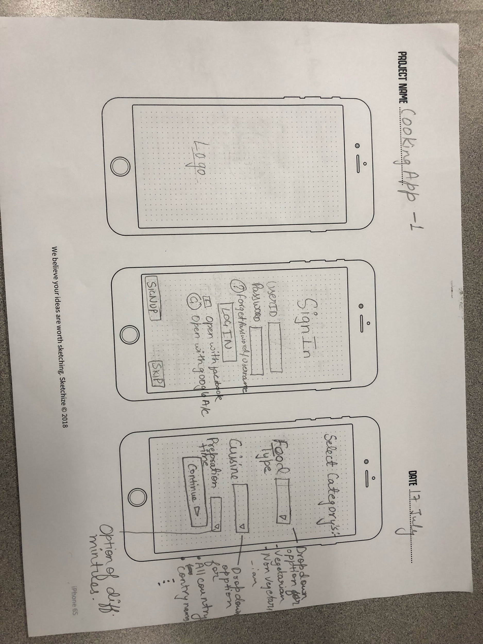
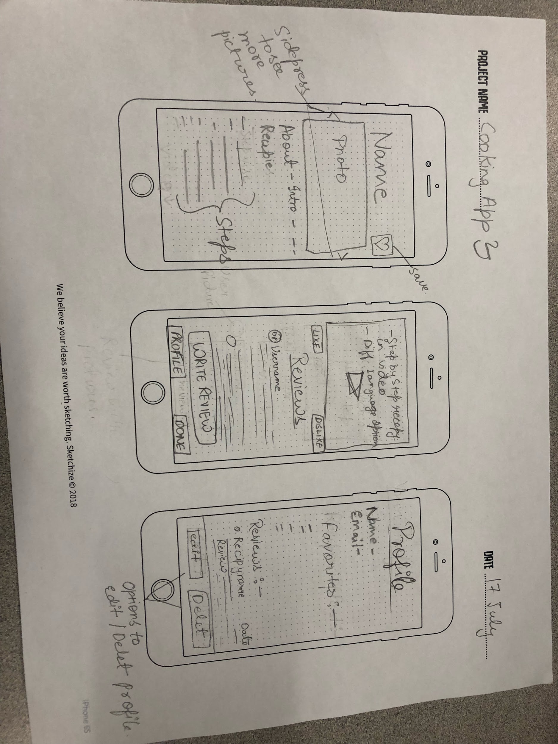
Low fidelity wireframe

Slide 16
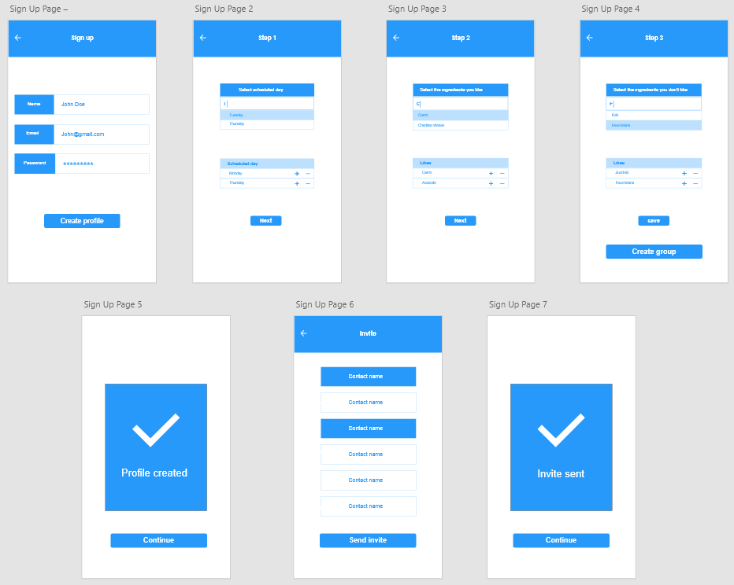
High fidelity wireframe

Slide 17
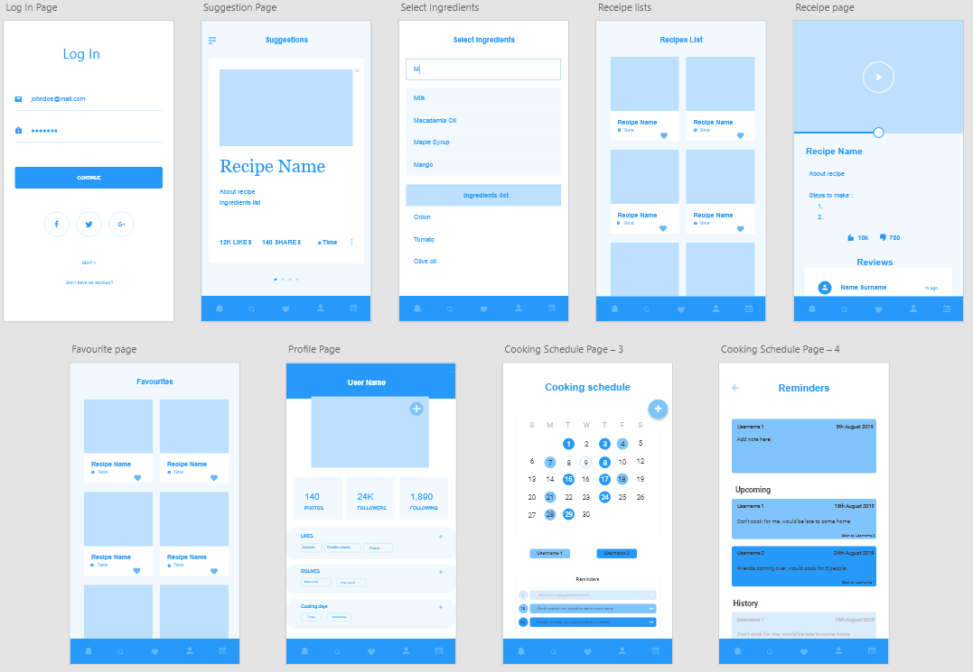

Slide 18

Final product

